Slide 1
Object Oriented Programming Lecture -9 POINTERS AND STRINGS
REFERENCE: 8.10 DIETEL
Object oriented programming
Spring 2024

Slide 2
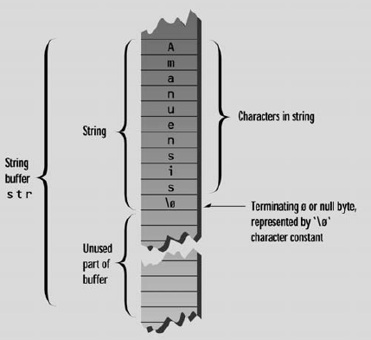
C-STRINGS
const int MAX = 80; //max characters in string
char str[MAX]; //string variable str
cout << “Enter a string: “;
cin >> str;

Slide 3
C-strings contd.
char str[] = “HELLO”;
Char str2[8]=“Hello”;
H | E | L | L | O | \0
H | E | L | L | O | \0
Last two cells are unused
We cannot do this:
Char str2[10];
str2=“World”; //not allowed

Slide 4
Character pointers
int main ()
{
char * s; //pointing to nothing
char a=‘x’;
s=&a;
char arr[]=“hello world”;
s=arr; //s pointing to an array arr
s=“fast- nu”; // s pointing to new memory now
}

Slide 5
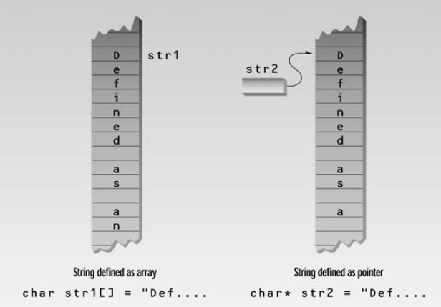
int main()
{
char str1[] = “Defined as an array”;
char* str2 = “Defined as a pointer”;
cout << str1 << endl;
cout << str2 << endl;
// str1++; // WRONG::str1 is constant
str2++; // this is OK, str2 is a pointer
cout << str2 ;
// now str2 starts “efined...”
return 0;
}
Output:
Defined as an array
Defined as a pointer
efined as a pointer

Slide 6
int main()
{
char* str = “defined as a pointer”;
cout << str << endl;
cout<<*str;
str++;
cout << *str ;
cout<<*(str+1);
return 0;
}
defined as a pointer
d
e
f

Slide 7
int main()
{
char temp[100]=“hello world”;
char *t;
t=temp;
while( *t ) //until null character,
cout << *t++; //print characters
return 0;
}
hello world

Slide 8
Why cout<< works differently for character arrays or pointers?
<< operator is overloaded for char arrays and pointers
<< operator prints the contents of character array instead of address of first location
In order to print address of first location we can do this:
cout<<&nameOfarray[0];

Slide 9
void display(char* ps)
{
while( *ps ) //until null character,
cout << *ps++; //print characters
cout << endl;
}
int main()
{
char str[50] = “Hello World”;
display(str); //display the string
display(“FAST-NU”); //we can also call this function like this
return 0;
}

Slide 10
int main()
{
char *pointers[3];
pointer[0]=“sunday”;
pointer[1]=“monday”;
pointer[2]=“tuesday”;
return 0;
}

Slide 11
const int DAYS = 7; //number of pointers in array
int main()
{
//array of pointers to char
char* arrptrs[DAYS] = { “Sunday”, “Monday”, “Tuesday”,
“Wednesday”, “Thursday”, “Friday”, “Saturday” };
for(int j=0; j<DAYS; j++) //display every string
cout << arrptrs[j] << endl;
return 0;
}

Slide 12
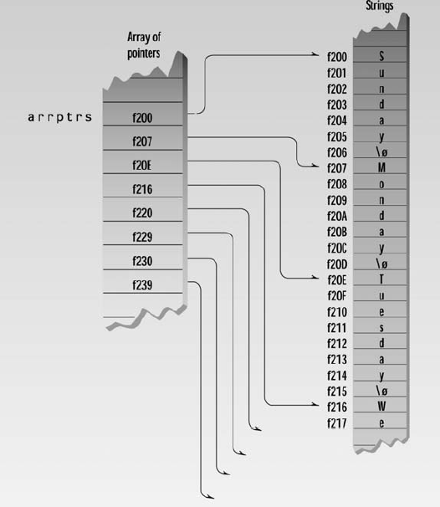

Slide 13
char* str = “National University”;
int len = strlen(str); //get length of str
//SHALLOW COPYING
char *a=str;
//DEEP COPYING
char* ptr; //make a pointer to char
ptr = new char[len+1]; //set aside memory: string + ‘\0’
strcpy(ptr, str); //copy str to new memory area ptr

Slide 14
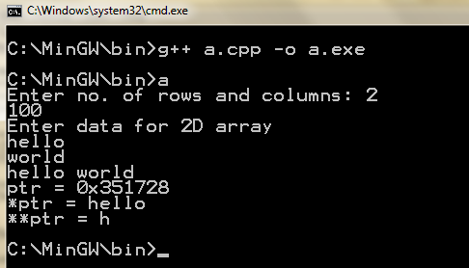
int main (){
int rows, col,i,j;
cout<<"Enter no. of rows and columns: ";
cin>>rows>>col;
char **ptr;
ptr = new char*[rows];
for (i=0; i<rows; i++)
ptr[i] = new char[col];
cout<<"Enter data for 2D array"<<endl;
for(i=0; i<rows; i++)
cin>>ptr[i];
for(i=0; i<rows; i++)
cout<<ptr[i] <<" ";
cout<<endl;
cout<<"ptr = "<<ptr<<endl;
cout<<"*ptr = "<<*ptr<<endl;
cout<<"**ptr = "<<**ptr<<endl;
return 0;
}

Slide 15
Struct pointers
struct studentType
{ char name[26]; double gpa; int id;char grade;
};
studentType student;
studentType *studentPtr;
studentPtr=&student;
studentPtr->gpa=3.5;
*(studentPtr).gpa=3.5;
same

